Slide 1
Steam Sales by dewar
24/7 Steam Discount Tracker

Slide 2
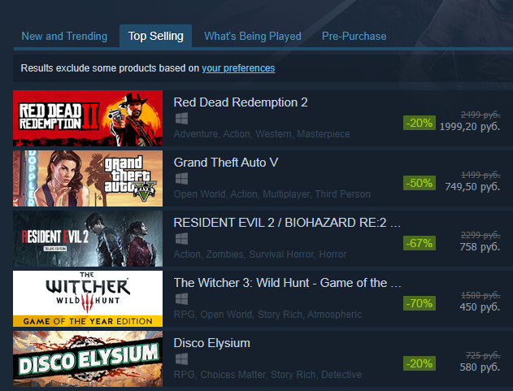
Goal
We need to collect information from this site: https://store.steampowered.com/specials#tab=TopSellers
After that, you need to send information to the program and send it to the output
We also need a beautiful interface for our application.

Slide 3
Mathematical development
Get HTML - page code
We get the tags we need
We process and filter information
We combine all the information and filter again
We create the graphic interface of the program
Create additional filtering according to user choice
We prescribe buttons and hotkeys, organize the output, modify the outer shell

Slide 4
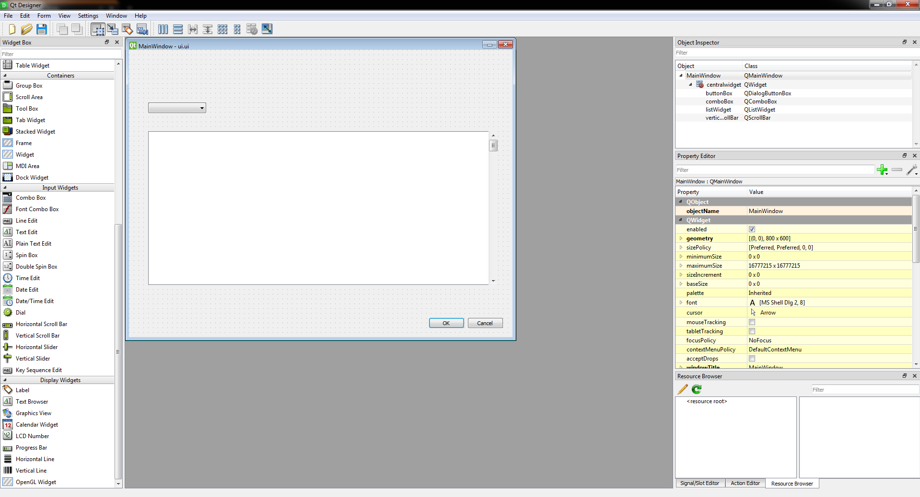
UI developing
Create a framework using PyQt5 Designer. At the initial stage, it consists of the ButtonBox, ComboBox, ListWidget, ScrollBar.

Slide 5
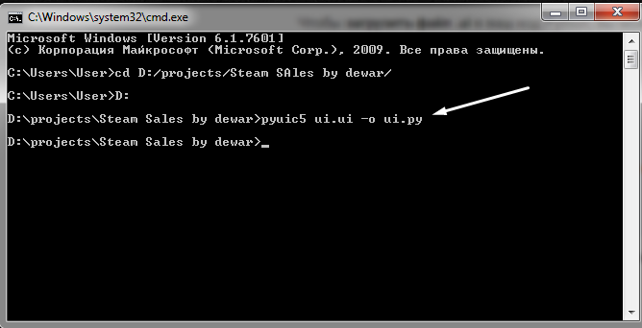
Change file extension
Convert the UI file to a file with the .py extension using the command line

Slide 6
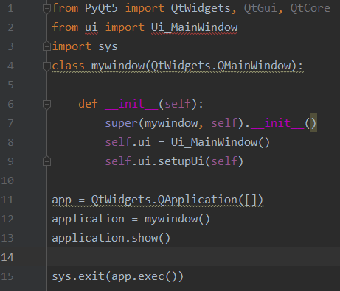
Program layout
Import UI
Window output and program closing correctly

Slide 7
Part I
Parser

Slide 8
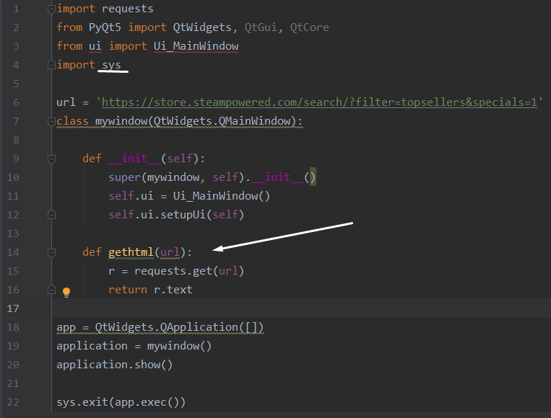
Getting HTML-code
We create a gethtml function that receives all the code from the site and returns in text form
We import the sys module necessary for this

Slide 9
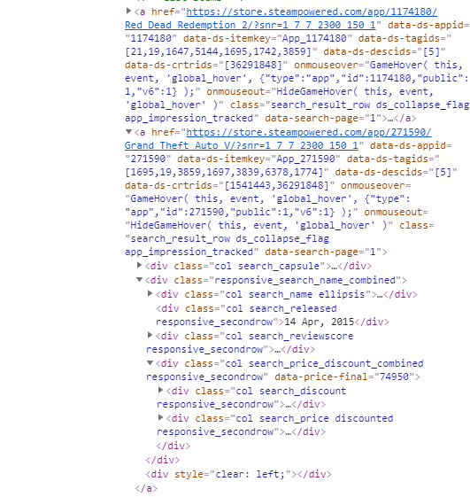
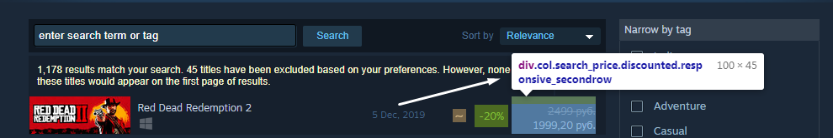
Tag search
Using the developer’s tools, we look through the page code and find the div element we need

Slide 10
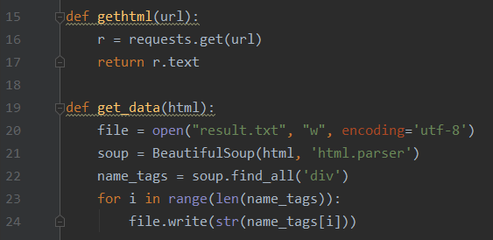
Div
We get the div elements and write to the file for tests

Slide 11
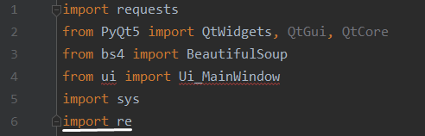
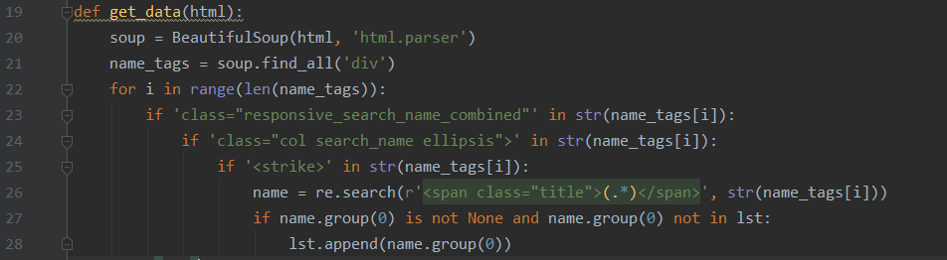
First check
To more accurately determine the location of the name of the game, we make several checks, after that we add the name to the list (it is still inside the tag)

Slide 12
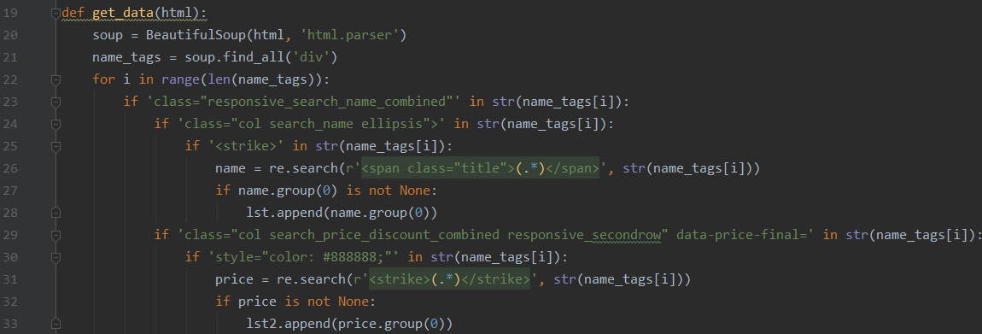
Parsing Old Value
Using additional conditions, add the search for the old price of the game, add to the list
Temporarily remove the verification of identical elements

Slide 13
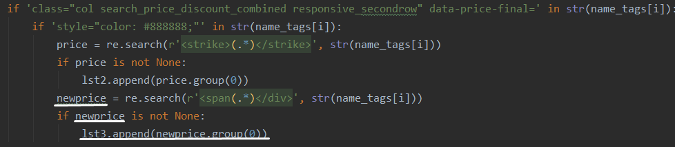
Parsing New Value
We insert the last condition into the functions and write the new price in the list lst3

Slide 14
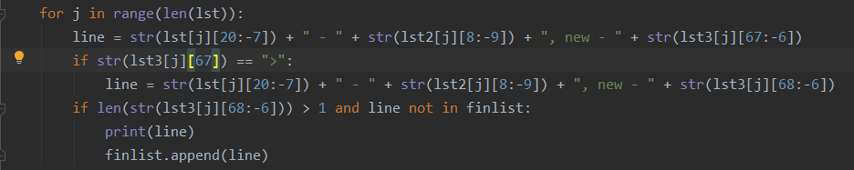
Output
We create a combined line output, including the name, hyphen, old value
Add a new price and new conditions: check the first character of the new price and check for reruns

Slide 15
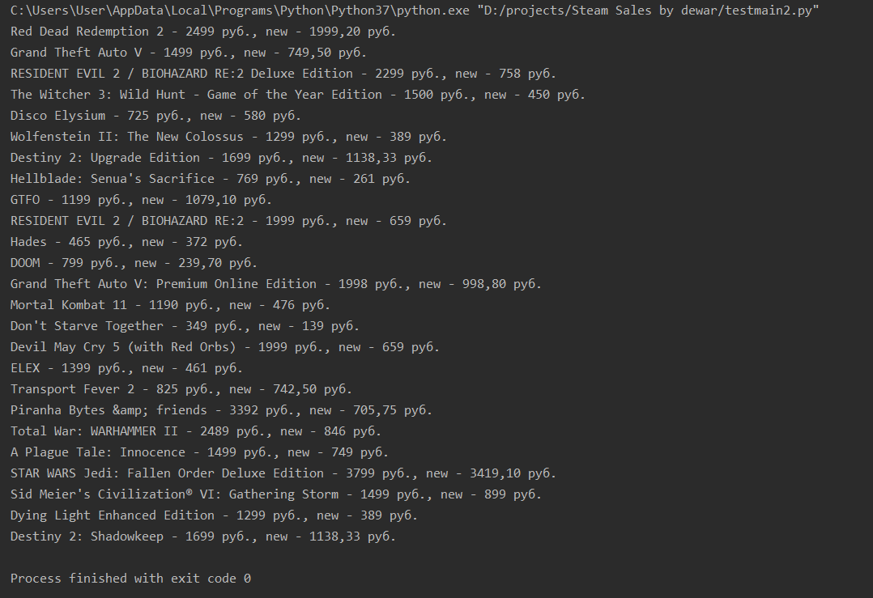
Result on this stage

Slide 16
Part II
Multi-page

Slide 17
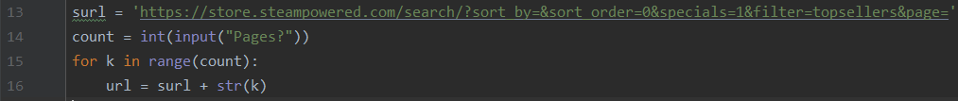
Multipage with input()
In order to change the number of iterable pages, we will change the URL. Add manual entry of the number of pages.
the page address in the Steam store is changed by changing the link and adding ‘pages =‘
Now add a loop that will change the URL itself

Slide 18
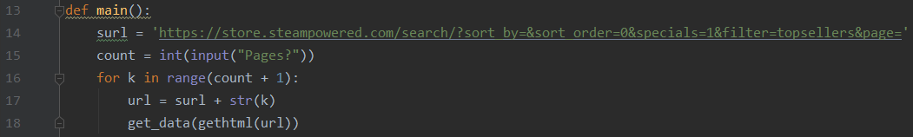
Multipage with input()
In order for all this to work, create a new main function

Slide 19
Part III
Work with UI

Slide 20
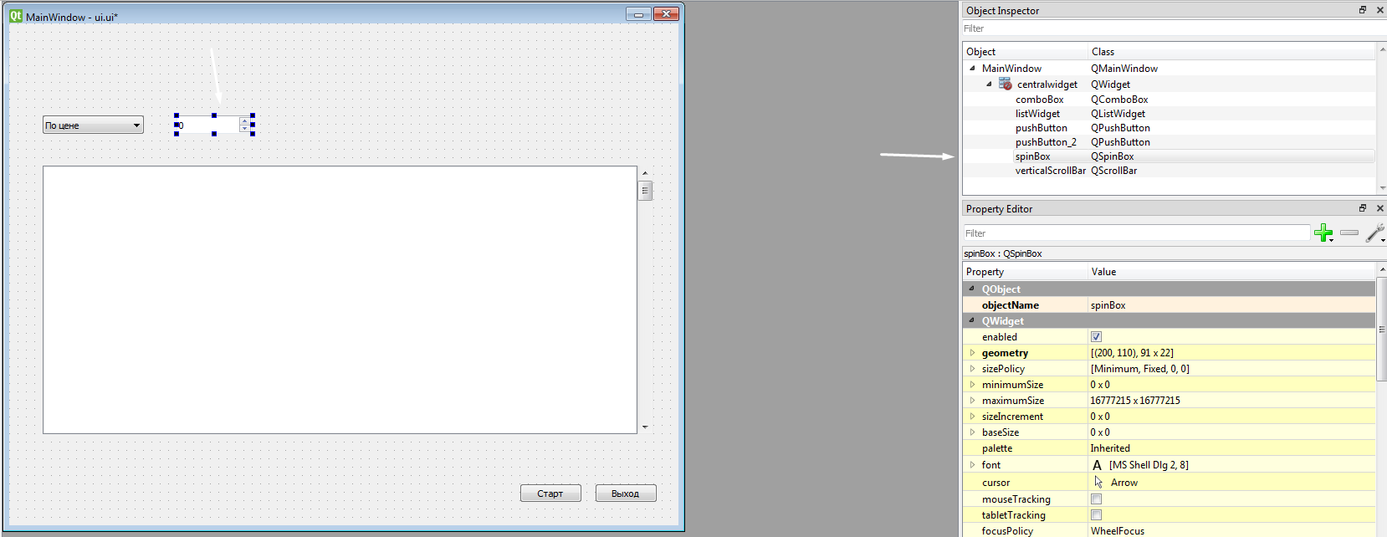
Changing UI
Now back to QT Designer and add SpinBox object

Slide 21
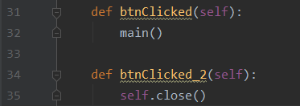
Assign actions to objects
Bind buttons to related functions
We create two functions: one for main execution, one for exit

Slide 22


Change a multi-page parser, namely input and output
Let's start with the input. We will take the number from SpinBox
Create a loop that will write values to the widget
We must not forget to remove the output to the console!

Slide 23
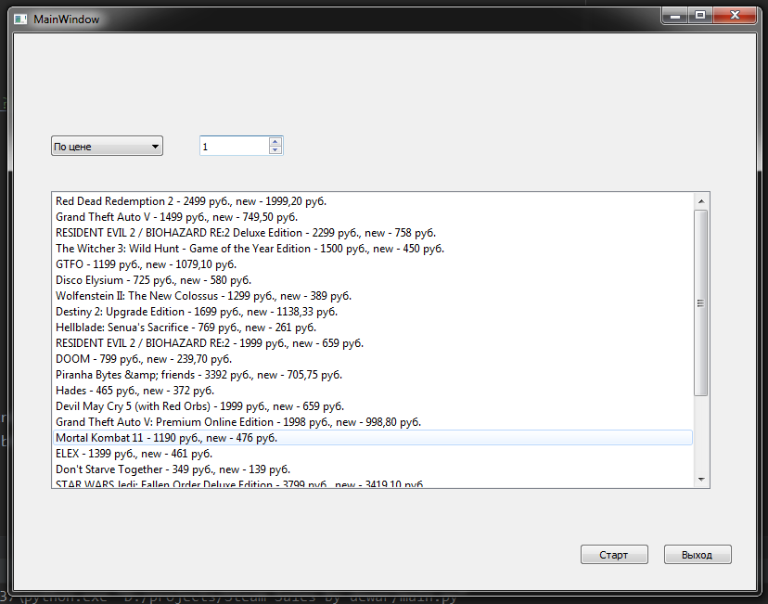
Now the program performs the most important function

Slide 24
Part IV
Appearance

Slide 25



Icon
Create a binaries folder, where we put our files
Using google we find the picture for the icon

Slide 26


Icon
Set the application icon
Name
Set the application name

Slide 27


Background
Using Adobe Photoshop, create a background for our application
We use the texture from the Steam website to display discounts.

Slide 28
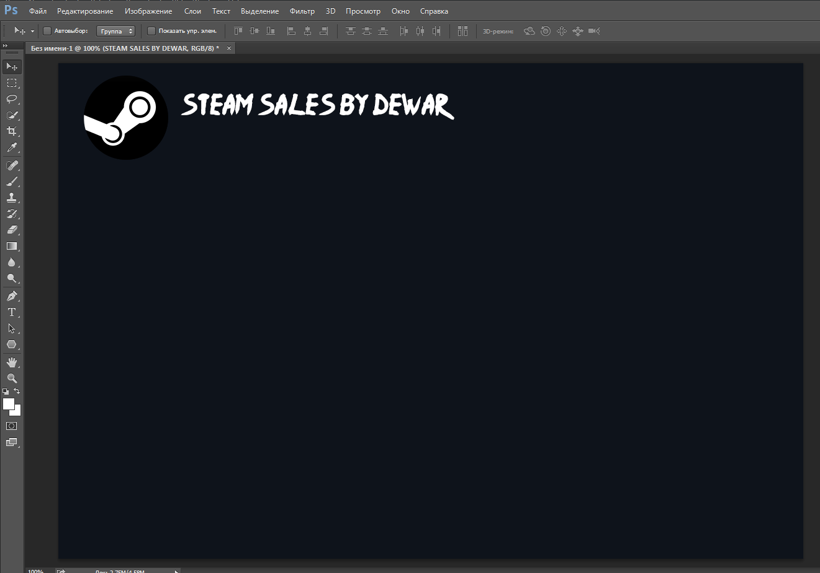
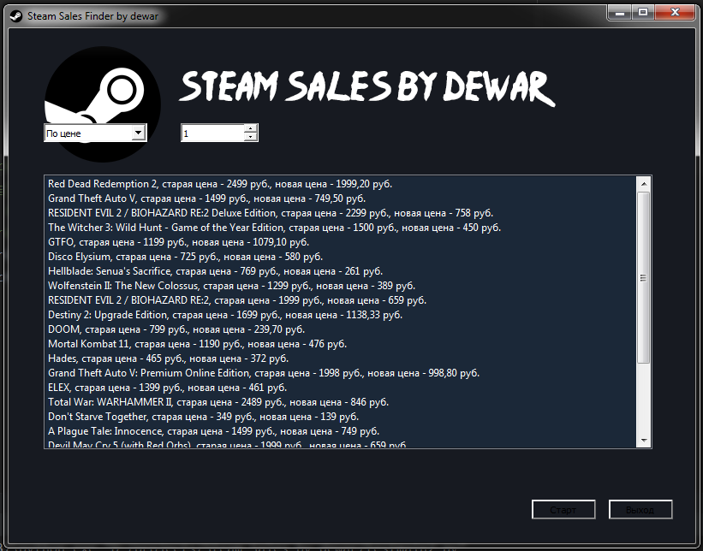
Background
We draw the general background of application
Set the background

Slide 29
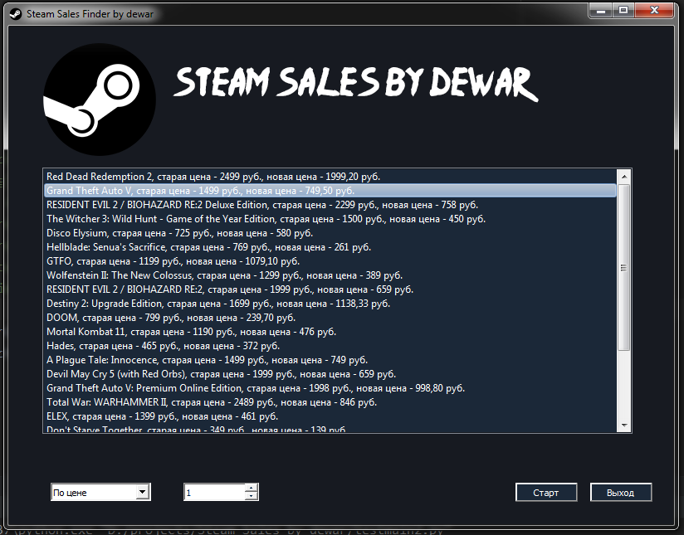
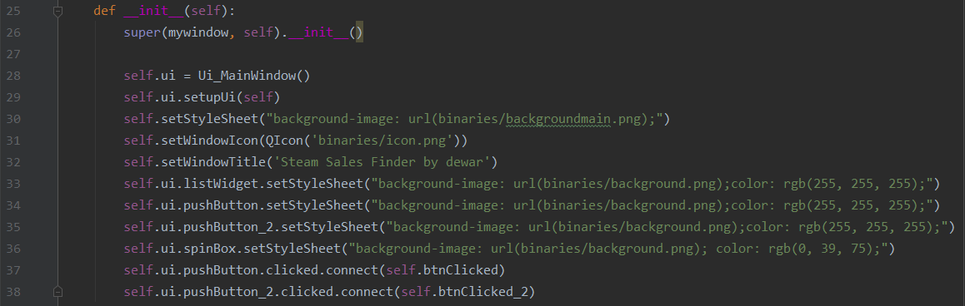
Finish the design
The appearance of the program is quite simple, but laconic, in addition to the above code, I also changed the settings of the UI in the PyQT designer

Slide 30
Part V
Filters

Slide 31
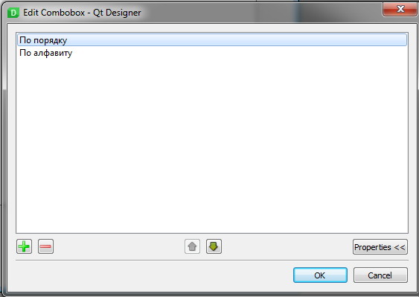
Editing Slots
In the ComboBox settings, we create two items: sorting in order, by alphabet

Slide 32
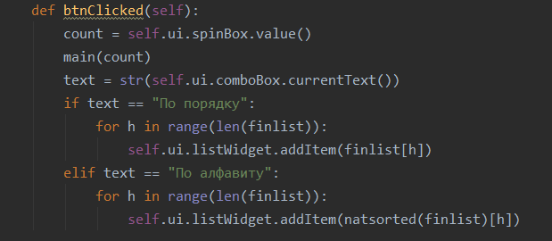
Conditions
We begin to write down the conditions, for this we extract the text from the ComboBox and compare

Slide 33
Part VI
Software List
Result

Slide 34
To write this program the following were used:
Python 3.7
JetBrains PyCharm Community Edition 2019.2.4
PyQt5 (+Qt Designer)
Adobe Photoshop CC 2014
Chrome Dev Tools (built-in google chrome browser)

Slide 35
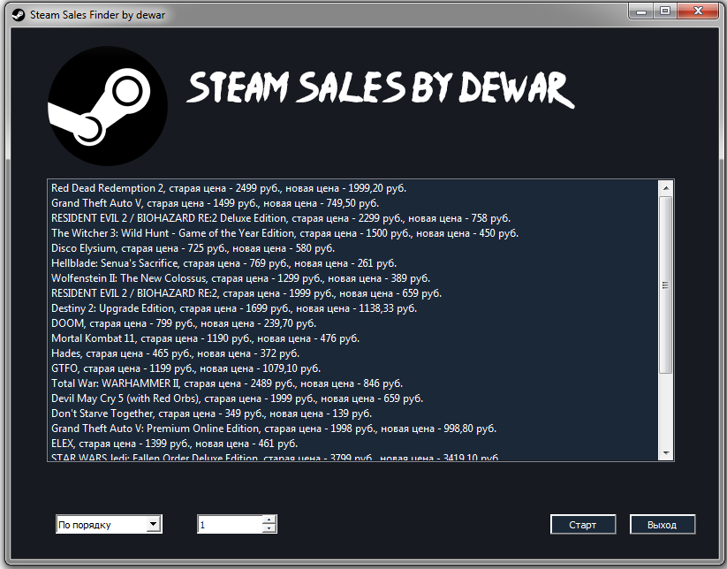
Steam Sales Finder
Without the use of multiprocessing, the parsing time of 1 page on the average machine is 12 seconds

